Slide 1


Actions & Basic Transformations

Slide 2
Content
Introduction & Presentation ETL Process
Actions & Basic Transformations
Advanced Transformations
Datavault

Slide 3

Goal of the learning sections
Import Data
Perform Basic Transformation
Perform Conditional Selection of Rows
Carry out basic Data Cleaning

Slide 4

Importing Data
Importing Data with .spark.read.options()

Slide 5
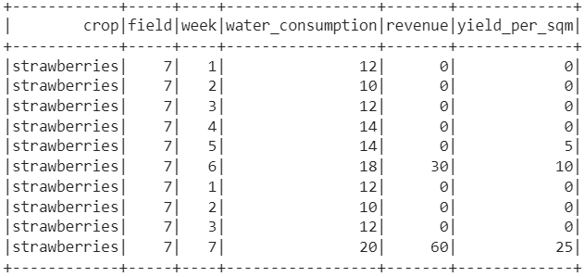
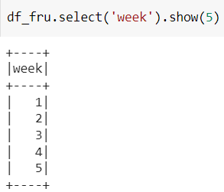
Accessing Columns
Accessing columns with .select()

Slide 6
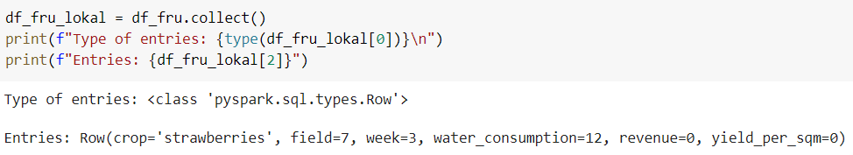
Accessing Rows
Accessing columns with workaround .collect() then access with print()
(and square brackets-operator for row)

Slide 7
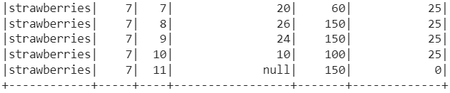
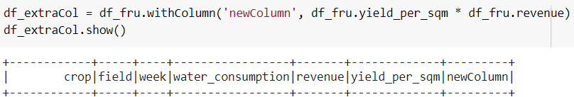
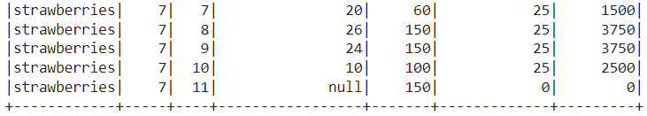
Adding Columns
Adding columns with .withColumn()

Slide 8
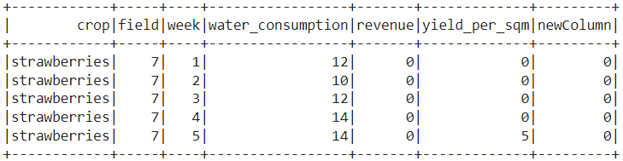
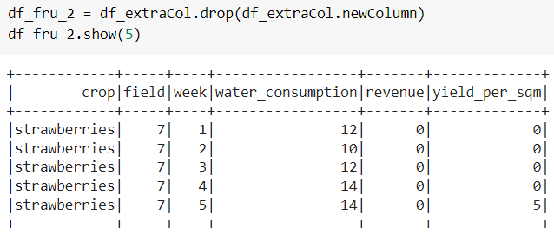
Removing Columns
Removing columns with .drop()

Slide 9
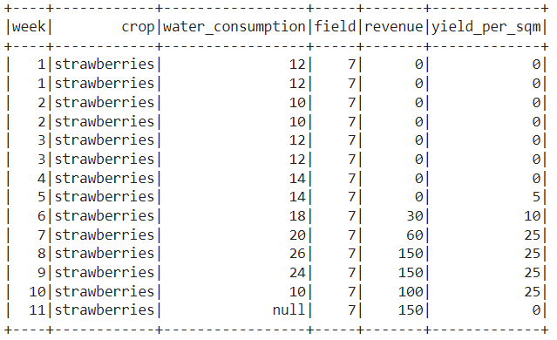
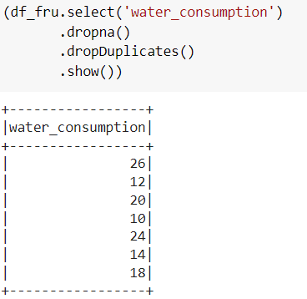
basic Data Cleaning
Removing NAs with .dropna()
Removing duplicates with .dropDuplicates()

Slide 10
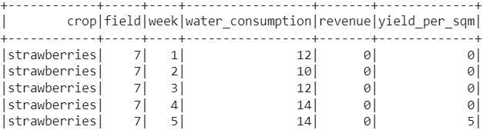
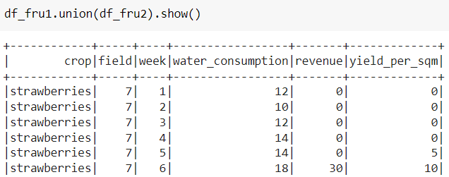
Concatenating DataFrames
Concatenating dataframes with .union()

Slide 11
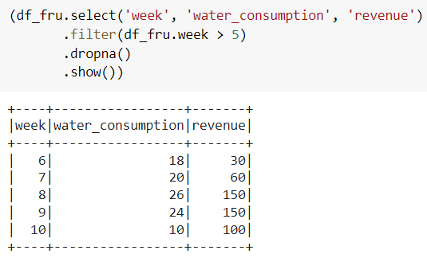
Perform Conditional Selection of Rows
Combining aggregate functions, to achieve exact selection: .filter()
.where()
.withColumn()
…

Slide 12
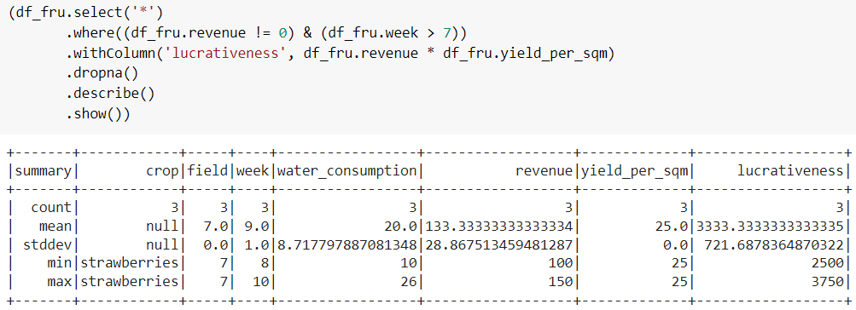
Perform Conditional Selection of Rows

